Slide 1
Review 2
Yuhsiang Hong

Slide 2
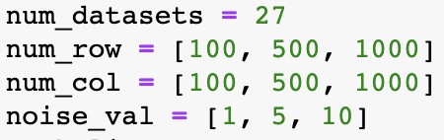
Dataset
Dataset: make_friedman1
Numbers of rows: 100, 500, 1000
Numbers of columns: 100, 500, 1000
Noise: 1, 5, 10
Total number of datasets: 27

Slide 3
Strategy
For each hyperparameter combination,
Use 5-fold cross-validation for each dataset
Calculate test RMSE (root-mean-squared-error) for each fold
Take the average of 5 test RMSE
Calculate the mean of all the average test RMSE among 27 datasets
Return all the values of each hyperparameter combination and then select the smallest one as my best result

Slide 4
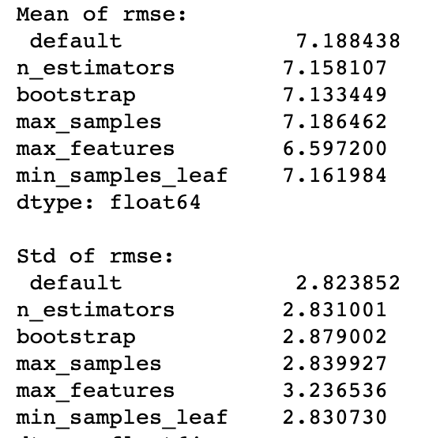
Tune One Hyperparameter (Random Forest)
Hyperparameter | Best result
n_estimators | 470
bootstrap | False
max_samples | 1 (default)
max_features | “auto”
min_samples_leaf | 1 (default)

Slide 5
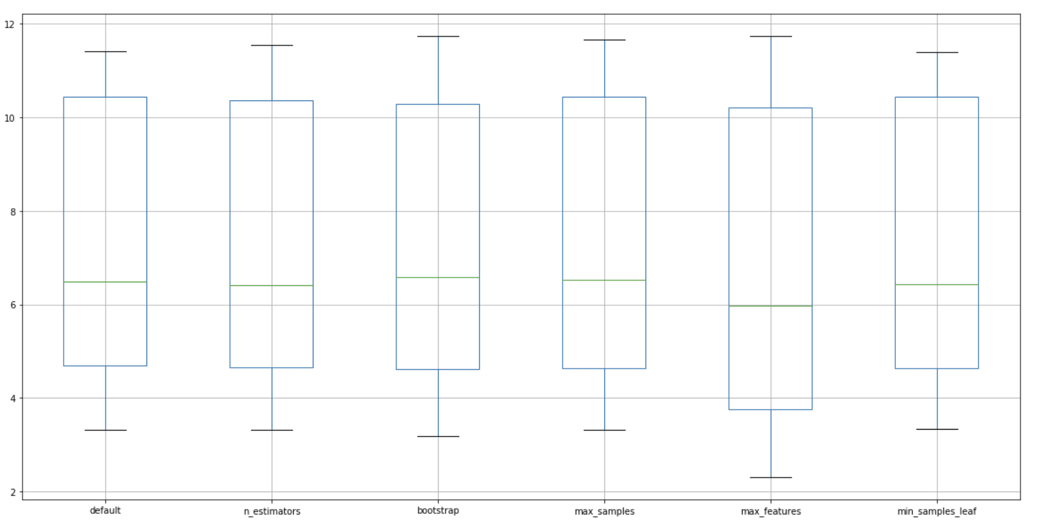
Tune One Hyperparameter (Random Forest)

Slide 6
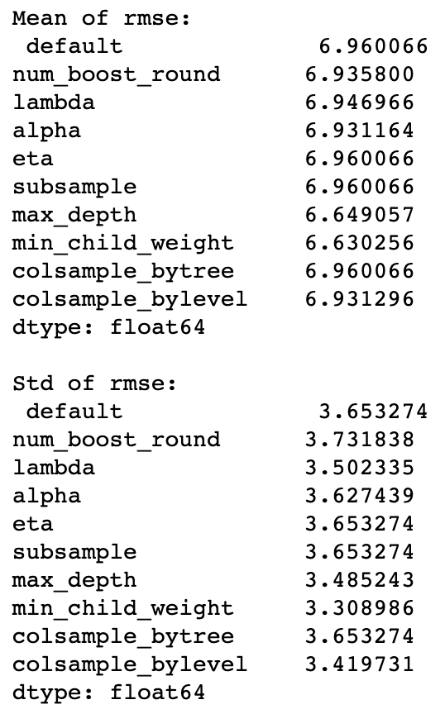
Tune One Hyperparameter (XGBoost)
Hyperparameter | Best result
num_boost_round | 20
lambda | 4
alpha | 0.0625
eta | 0.3 (default)
subsample | 1 (default)
max_depth | 2
min_child_weight | 64
colsample_bytree | 1 (default)
colsample_bylevel | 0.3

Slide 7
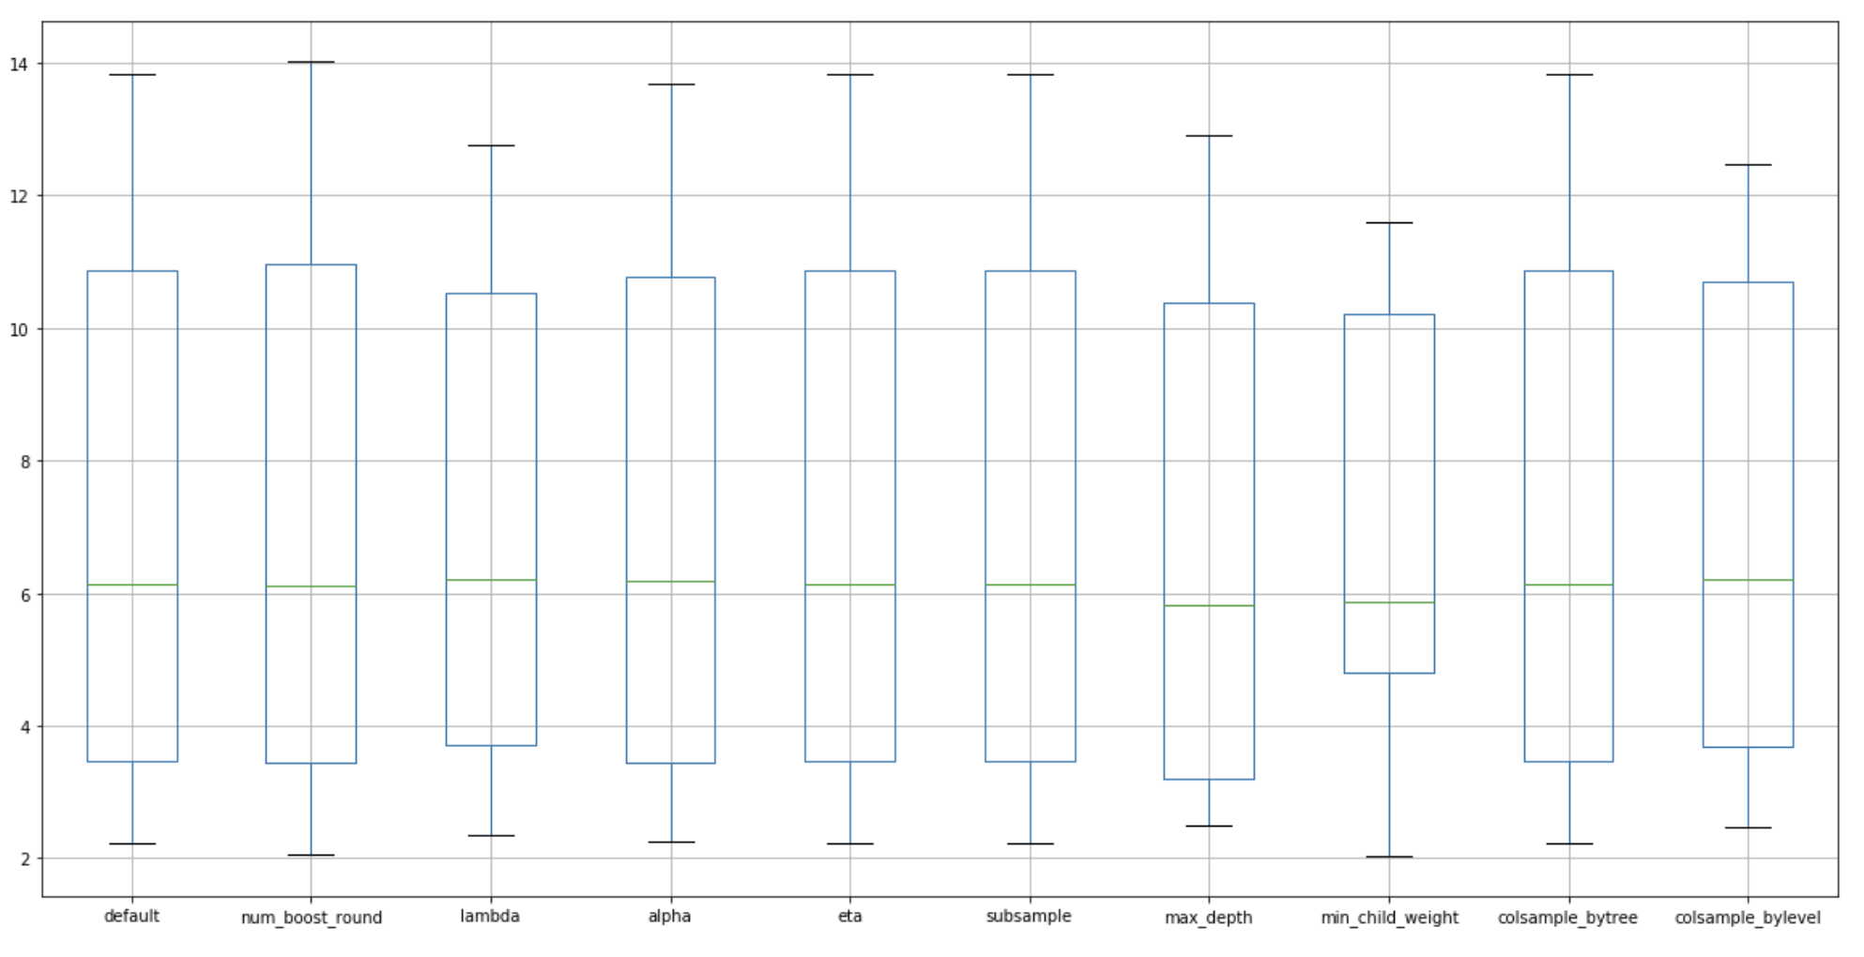
Tune One Hyperparameter (XGBoost)

Slide 8
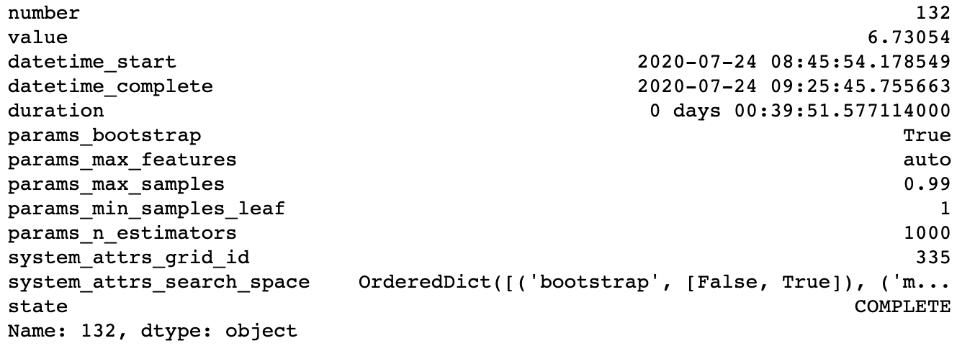
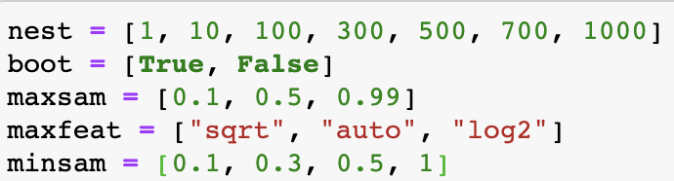
Grid Search (Random Forest)

Slide 9
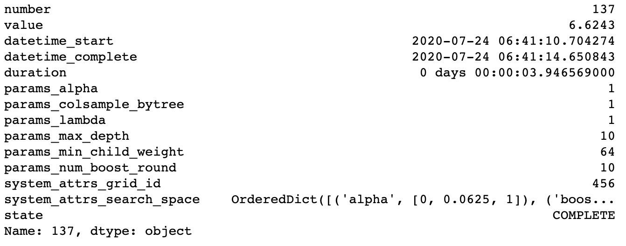
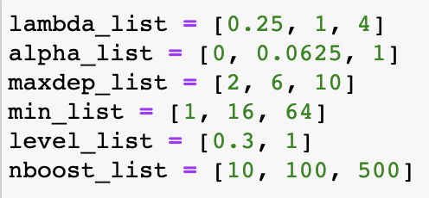
Grid Search (XGBoost)

Slide 10
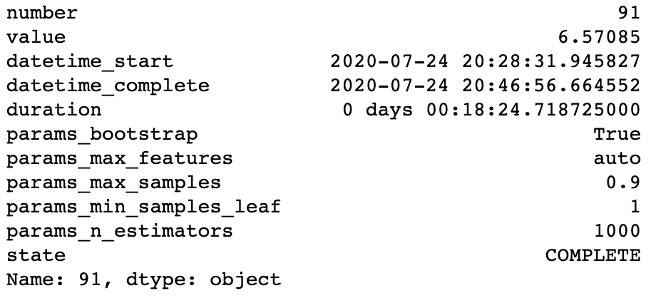
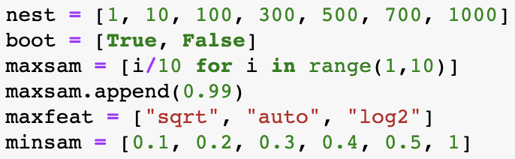
Random Search (Random Forest)

Slide 11
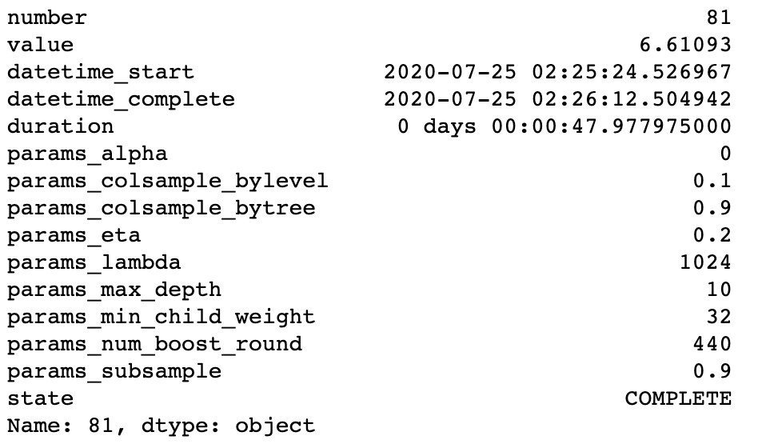
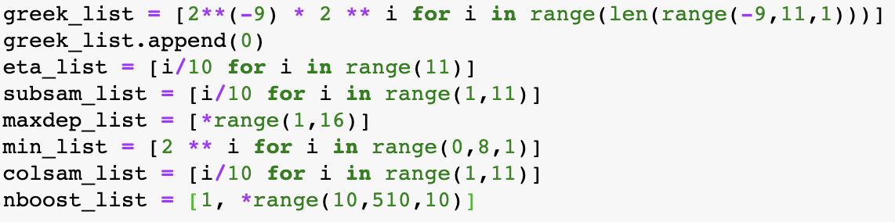
Random Search (XGBoost)

Slide 12
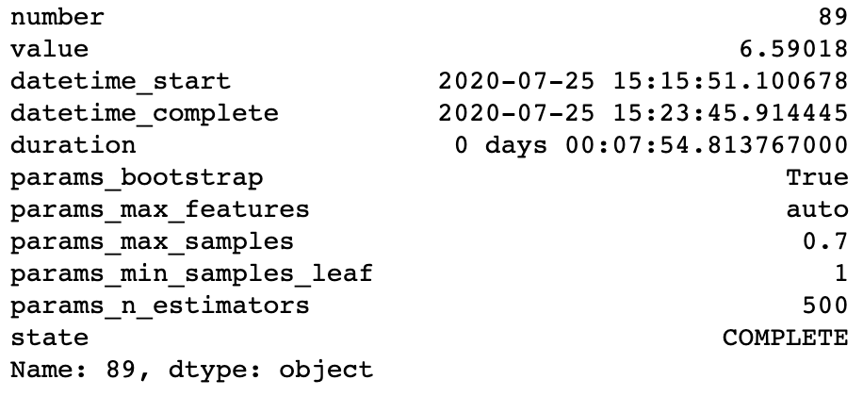
Bayesian Optimization (Random Forest)

Slide 13
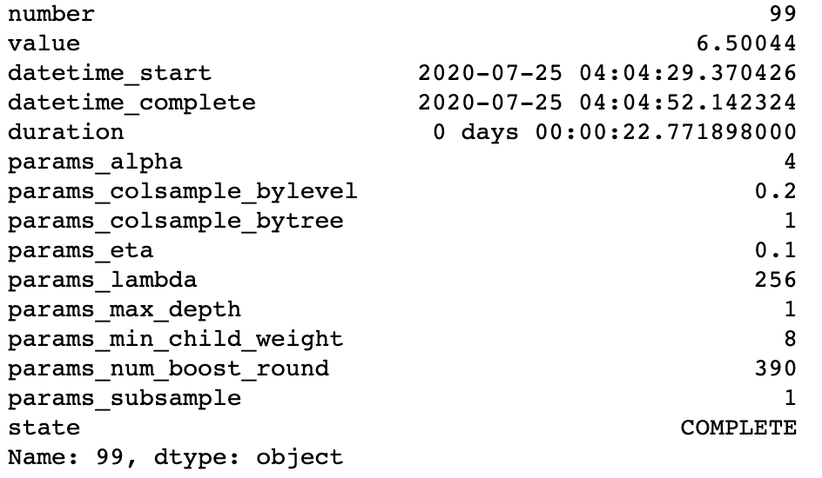
Bayesian Optimization (XGBoost)

Slide 14
Thank you!

